Slide 1
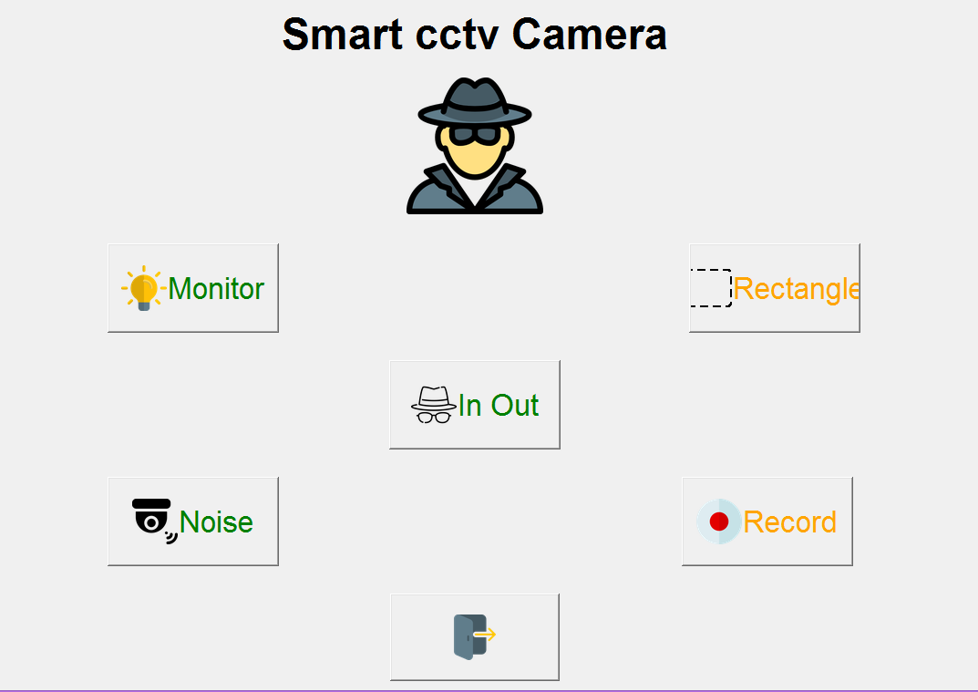
SMART CCTV
-BY
Krushnal Soni (17it111)
Savan Varotariya(17it129)

Slide 2
Overview
Introduction
Flow Chart
DFD diagram
About Project
Opencv , Tkinter python
Modules in Project
Hardware and software requirements
Functional Requirements(Scope)
Advantages and Disadvantages

Slide 3
Introduction
The issue of mass surveillance in CCTV camera feed is very important. Surveillance can be of different forms like malicious activity detection, identification of a particular entity particular individual in a CCTV video or in general keeping tracks of movements of human beings.
In our project, the focus has been given to find the path of human through the CCTV cameras also called tracking through object detection via image processing .

Slide 4
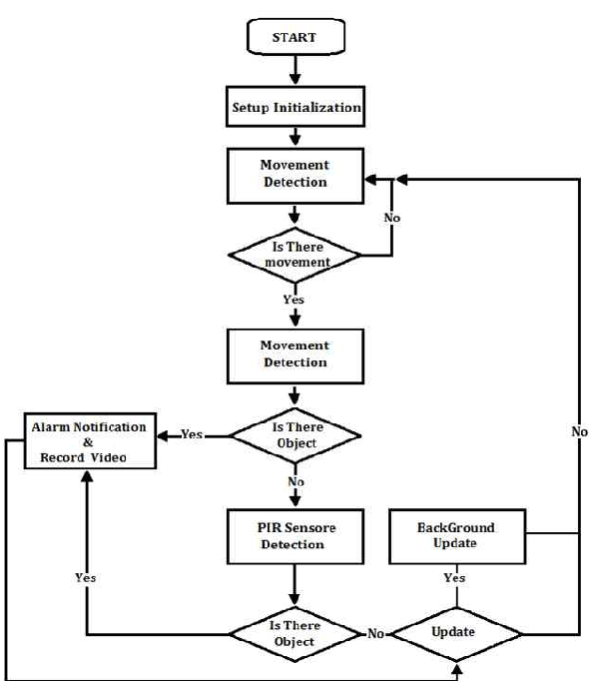
Flow Chart

Slide 5
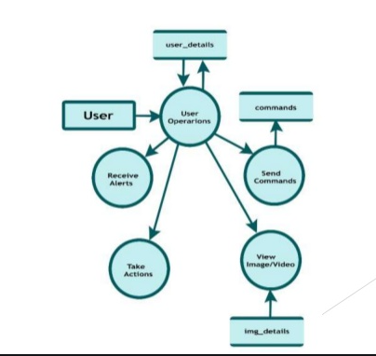
DFD Diagram

Slide 6
About Project
We have made this project in python , machine learning basically in this project we have used opencv library as we know that it is huge open source library for computer vision , machine learning and image processing.
Basically our aim in this project is to make cctv which record all the activity of a person like in and out time , monitoring , record the footage and many more.
Also we have used PIL (Python Imaging Library)which provides the python interpreter with image editing capabilities. Supports Image Archieve we can convert image from one format to another.

Slide 7
Opencv
OpenCV is a huge open-source library for computer vision, machine learning, and image processing. OpenCV supports a wide variety of programming languages like Python, C++, Java, etc.
It can process images and videos to identify objects, faces, or even the handwriting of a human. When it is integrated with various libraries, such as Numpy which is a highly optimized library for numerical operations, whatever operations one can do in Numpy can be combined with OpenCV.
This OpenCV tutorial will help you learn the Image-processing from Basics to Advance, like operations on Images, Videos using a huge set of Opencv-programs and projects.

Slide 8
Tkinter Python
Tkinter is the standard GUI library for Python. Python when combined with Tkinter provides a fast and easy way to create GUI applications. Tkinter provides a powerful object-oriented interface to the Tk GUI toolkit. Import the Tkinter module.
Creating a GUI application using Tkinter is an easy task. All you need to do is perform the following steps −
Import the Tkinter module.
Create the GUI application main window.
Add one or more of the above-mentioned widgets to the GUI application.
Enter the main event loop to take action against each event triggered by the user.
It consist of 15 types of widgets some of there are Button, Canavas , Frame , Entry , Label , Menu , Message and many more.

Slide 9
Modules of our project
Monitor
A CCTV monitor is a display device that is usually connected to a feed from a surveillance video recording device.
In and Out
It generally records data of person which time he/she enters and at which time he exits in in folder and out folder.
Rectangle
In this it tells us to choose the directon or we can say we have to choose the portion , if there’s motion in that portion then it will record / track it in the form of document .
Record
This function in our project is been used to record the footage we have to start recording and it would save the recording when we stop so we can say it is like video recorder .

Slide 10
Hardware and software requirements
Tools and Technology:-
Image processing with Core Python
Hardware requirements :
1) x64 based processor
2) 4GB RAM
Software requirements :
1)Python 3.6 and above
2) Packages: Opencv tkinter , PIL

Slide 11
Functional Requirements(Scope)
Image processing via object detecion.
Detect -> Process -> store – it means that first it would detect the user then it will process the image after image processing is done after that it will store in form of image/video after tracking in camera .

Slide 12
Advantages and Disadvantages
Advantages :-
1) Monitors activities.
2) Collect evidence.
3) Decision Making.
4) Keep records.
Disadvantages :-
1) One of the biggest disadvantages of CCTV use deals with privacy, especially when used in the workplace.
2) Expensive , doesnot stop crime.

Slide 13
Learning Outcome :
While making this project we have explored python libraries like opencv, PIL, Tkinter also we have learned concept of image processing , how to detect object in our application/project , how to store image in different formats with the use of PIL library .

